Slide 1
Practical =2
FYCS =58
Mohammed tausif

Slide 2
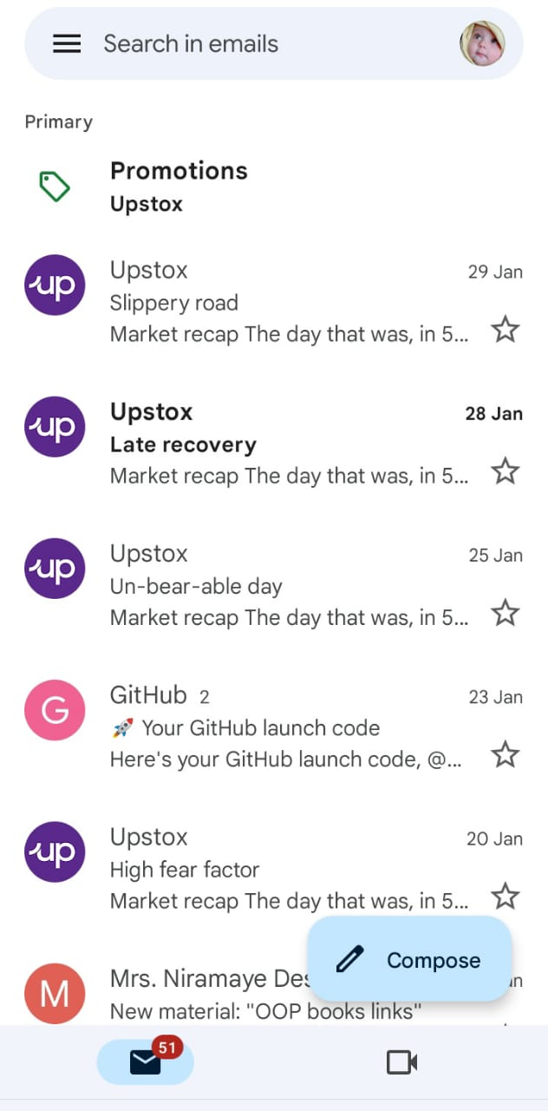
1 = Go to Gmail
2 =click button compose
Compose button

Slide 3
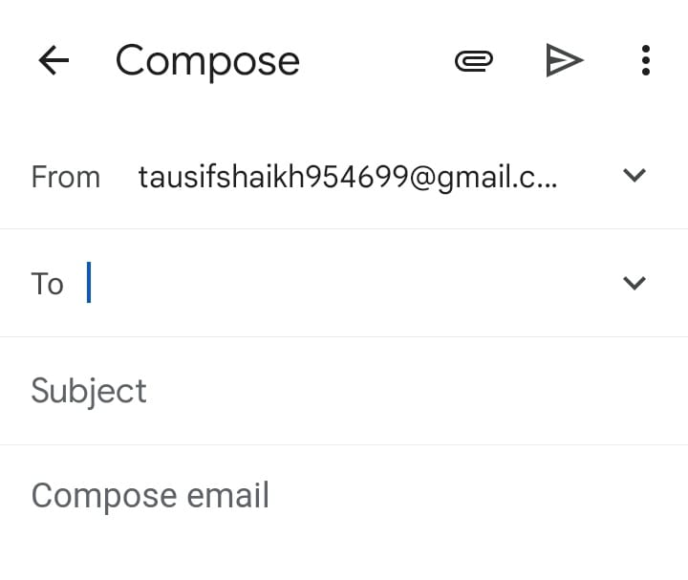
3 = ‘to’ write email next person(as we send)
4 = ‘subject’ write short term aim
5 = ‘compose email’ explain aim
6 = click’submit button’
Photo ,file, pdf attach
button
Submit button

